Slide 1


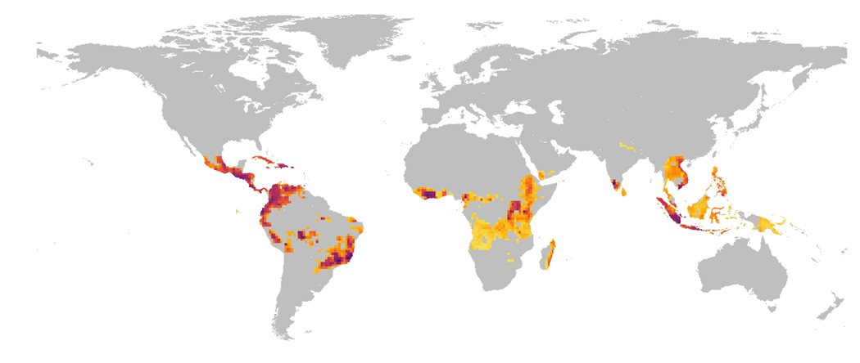




Epidemic forecasting
Tackling Global Challenges in Plant Pathology with AI: Forecasting, Imaging, and Protein Prediction
A.I. Plex Sulá and the Garrett Lab
Notes:
Your presentation is scheduled for 8/4/2025, from 2:30 PM to 2:45 PM
Let's start this presentation with two simple but big questions: If we were to prioritize biosecurity efforts, how and where would we do it globally? Fortunately, my today’s audience includes plant pathologists willing to solve the big problem. Because data availability is a huge gap and there is a lot of uncertainty, here we provide only first approximations to answering these questions.
Invasive pathogens.

Slide 2
Learning objectives
The student will…
Learn the fundamental steps for building supervised machine-learning models
Build a random forest model that accurately predict epidemics
Be familiarized with the terminology of supervised machine learning
PLANT HEALTH 2025
DOI: 10.1146/annurev-phyto-121423-093855
Notes:
ADD ANIMATIONS AND FROM PREVIOUS PRESENTATIONS

Slide 3


These resources are available at
https://www.manning.com/books/machine-learning-with-r-the-tidyverse-and-mlr (for concepts
https://mlr3book.mlr-org.com/ (for current code)

Slide 4


Before starting session, please run the R code in Google Colab
The R code template is available at
https://colab.research.google.com/drive/1AeSFSa-6CD0oLyhwG8bUnATs_fPSKB-O?usp=drive_link
PLANT HEALTH 2025
DOI: 10.1146/annurev-phyto-121423-093855
Notes:
ADD THE ICON OF GOOGLE COLLAB HERE

Slide 5
General overview of the machine learning process
Data for training
Learner
Data
Resampling
Data for testing
Model
Performance
Measure
Prediction
PLANT HEALTH 2025
Adapted from the mlr3 Book
Notes:
`

Slide 6
4 general components of supervised learning
Task: The common task in supervised learning is to predict a target variable based on a set of features.
An algorithm learns patterns from labeled data.
Classification algorithms are used to predict categorical output variables.
Regression algorithms are used to predict continuous output variables.
Dataset
Target or output variable (“dependent or response variable”)
Features (“independent or predictor variables”)
Learner (algorithms) and predictions
PLANT HEALTH 2025
DOI: 10.1146/annurev-phyto-121423-093855
Notes:
`

Slide 7
General overview of the machine learning process
Data for training
Learner
Data
Resampling
Data for testing
Model
Performance
Measure
Prediction
PLANT HEALTH 2025
Adapted from the mlr3 Book
Notes:
`

Slide 8

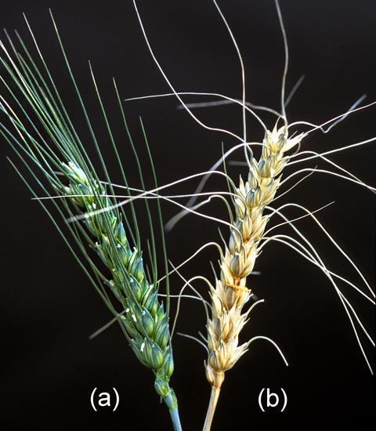
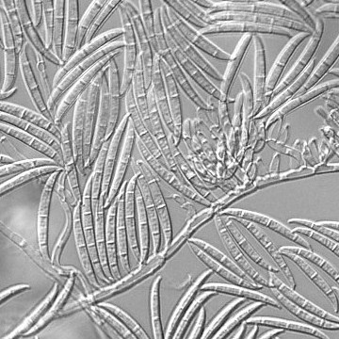
Understanding your data
Credit: Keith Weller
Credit: Wikipedia
PLANT HEALTH 2025
DOI: 10.1094/PHYTO-10-22-0380-R
Notes:
r

Slide 9
Fusarium head blight dataset
A dataset
999 observations (rows)
338 variables (columns)
Features
330 possible predictor variables
All predictors are numeric
Target variable
FHB epidemics in the United States (1982-2015)
1 represents epidemic (27%)
0 represents no epidemic (73%)
PLANT HEALTH 2025
GitHub repository https://github.com/DenisAShah/RFVariableSelectionwithFHB
Notes:
`

Slide 10
General overview of the machine learning process
Data for training
Learner
Data
Resampling
Data for testing
Model
Performance
Measure
Prediction
PLANT HEALTH 2025
Add reference here
Notes:
`

Slide 11

“All models are wrong, but some are useful” George E. P. Box
Machine learning algorithms include
Algorithms for classification | Algorithms for regression
K-nearest neighbors (kNN) | K-nearest neighbors (kNN)
Logistic regression | Generalized additive models
Support vector machines | Support vector machines, ridge regression
Naive Bayes model | LASSO and elastic net
Decision trees, random forest… | Random forest, XGBoost…
PLANT HEALTH 2025
Add reference here
Notes:
`“All models are wrong, but some are useful” – George Box
No free lunch theorem - While certain algorithms tend to perform better than others with certain types of data, no single algorithm will always outperform all others on all problems.

Slide 12

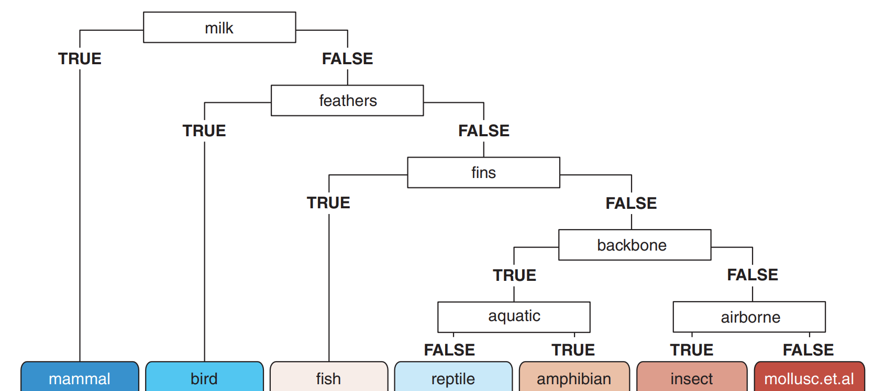
Simple structure of a decision tree
Components
Root node
Nodes
Leaves
PLANT HEALTH 2025
Adapted from Hefin I. Rhys (2020)

Slide 13

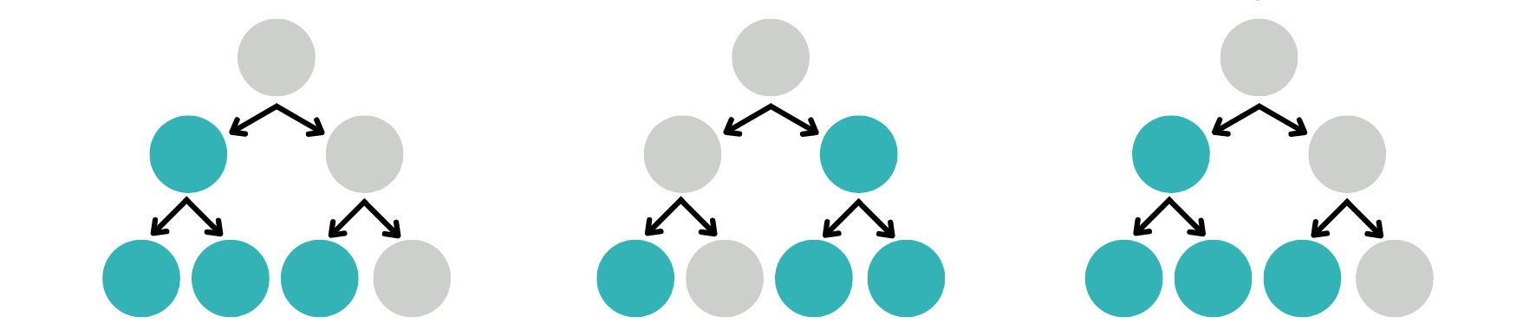
What is a random forest?
Original dataset
Random sample
Random sample
Random sample
Decision tree 1
Decision tree 2
Decision tree N
Prediction 1
Prediction 2
Prediction N
Modal or consensus prediction
PLANT HEALTH 2025
Adapted from Hefin I. Rhys (2020)

Slide 14
General overview of the machine learning process
Data for training
Learner
Data
Resampling
Data for testing
Model
Performance
Measure
Prediction
PLANT HEALTH 2025
Adapted from the mlr3 Book
Notes:
`

Slide 15
Supervised machine learning
Our task is to correctly classify each observation in the FHB dataset on whether an epidemic occur or not.
Why is this problem considered a classification?
PLANT HEALTH 2025
Add reference here
Notes:
`

Slide 16
General overview of the machine learning process
Data for training
Learner
Data
Resampling
Data for testing
Model
Performance
Measure
Prediction
PLANT HEALTH 2025
Add reference here
Notes:
`

Slide 17
Cross-validation approaches
There are three common cross-validation approaches
Holdout CV
Leave-one-out CV
K-fold CV
PLANT HEALTH 2025
Adapted from Hefin I. Rhys (2020)

Slide 18
Feature selection
Goal
Determine which features are most relevant for a specific task.
Multicollinearity
Two or more predictor variables are highly correlated with each other.
Criteria for selection
Biological meaning (weather conditions relative to anthesis)
Correlation analysis (> 0.9)
Random forests
PLANT HEALTH 2025
Add reference here
Notes:
ADD A GOOD DATA SCIENTIST HERE (ChatGPT)

Slide 19
Feature selection using the Random Forest family of algorithms
The goal of feature selection is to determine which features are important for a specific task.
Three wrapper algorithms
Boruta algorithm
Each variable is confirmed, rejected, tentative.
varSelRF
Variables are selected from random forests using OOB error
VSURF
Variable Selection Using Random Forests
PLANT HEALTH 2025
Add reference here
Notes:
`

Slide 20
General overview of the machine learning process
Data for training
Learner
Data
Resampling
Data for testing
Model
Performance
Measure
Prediction
PLANT HEALTH 2025
Add reference here
Notes:
`

Slide 21
A random forest for Fusarium head blight!
Select best predictor variables
Train the random forest model
Validate the random forest model
Measure model accuracy by comparing model predictions with unseen observations
How well our random forest predicts whether a location will experience an FHB epidemic or not.
PLANT HEALTH 2025
Add reference here
Notes:
`

Slide 22
AUC ROC: Area under Receiver Operating Characteristic curve
Perfect model
True positives:
The number of cases correctly classified as epidemic by the model.
False positives:
The number of cases where the model predicted epidemics, yet no epidemics occurred in the field.
Good model
0 True positive rate 1
Random model
0 False positive rate 1
PLANT HEALTH 2025
https://en.wikipedia.org/wiki/Receiver_operating_characteristic
Notes:
Add quiz question symbol

Slide 23
Hyperparameter tuning
What is a parameter?
A parameter is a variable or value that is estimated from the data and that is internal to the model and controls how it makes predictions on new data.
What is hyperparameter?
A hyperparameter is a variable or option that controls how a model makes predictions but is NOT estimated from the data.
What is the objective of hyperparameter tuning?
Hyperparameter tuning is the problem of choosing a set of optimal hyperparameters for a learning algorithm.
PLANT HEALTH 2025
Add reference here
Notes:
`

Slide 24
Hyperparameters in a random forest
num.trees – the number of individual trees in the forest
mtry – the number of features to randomly sample at each node
min.node.size – the minimum number of cases allowed in a leaf
splitrule – Metric used to evaluate the quality of a split
Q: How do we know what are the best values for each hyperparameter?
A: In random forest, the Gini index is regularly used as our objective function to determine the best split at each node.
PLANT HEALTH 2025
Add reference here
Notes:
`

Slide 25

Model interpretation
SHAP values
In machine learning, SHAP (SHapley Additive exPlanations) values quantify how much each feature contributes to the model’s prediction for each observation.
Further reading: https://dl.acm.org/doi/10.5555/3295222.329523
PLANT HEALTH 2025
DOI: 10.5555/3295222.329523
Notes:
`

Slide 26
Take home messages
Conclusions
Generic framework
Pros and cons
There is a general pipeline for any machine-learning model that helps in good data science.
The major benefit of ML is the increased predictive power. ML does not provide explicitly causal explanations.
Terminology
Ensemble approach
Keep track of potentially climatically suitable regions considering current and future risk scenarios.
Multiple models might mitigate the error of other models.
PLANT HEALTH 2025

Slide 27


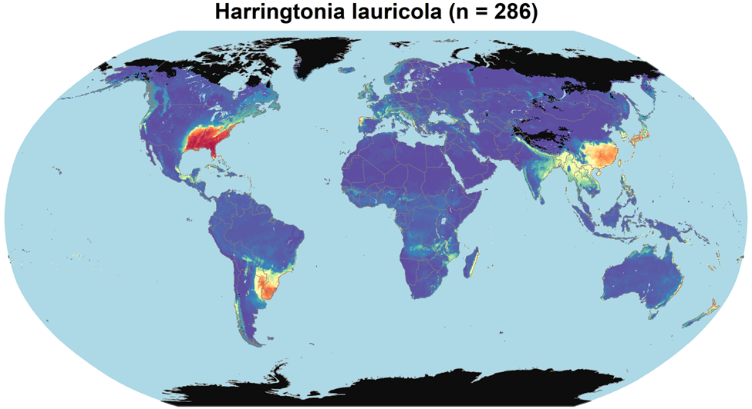
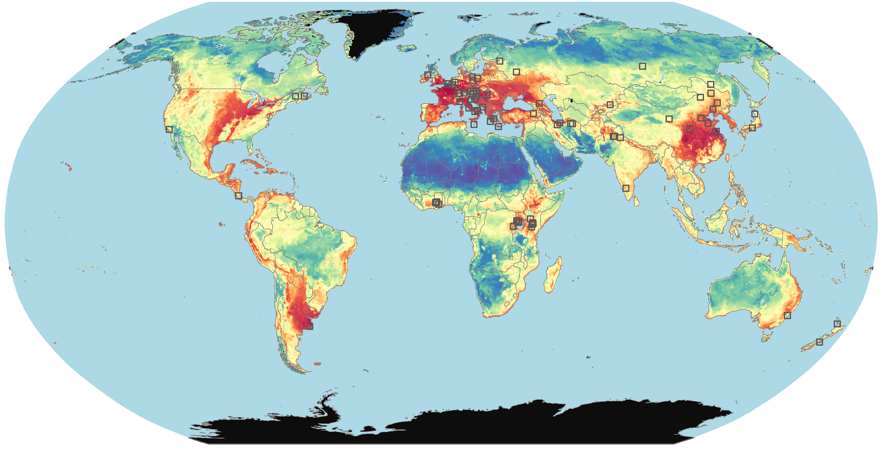
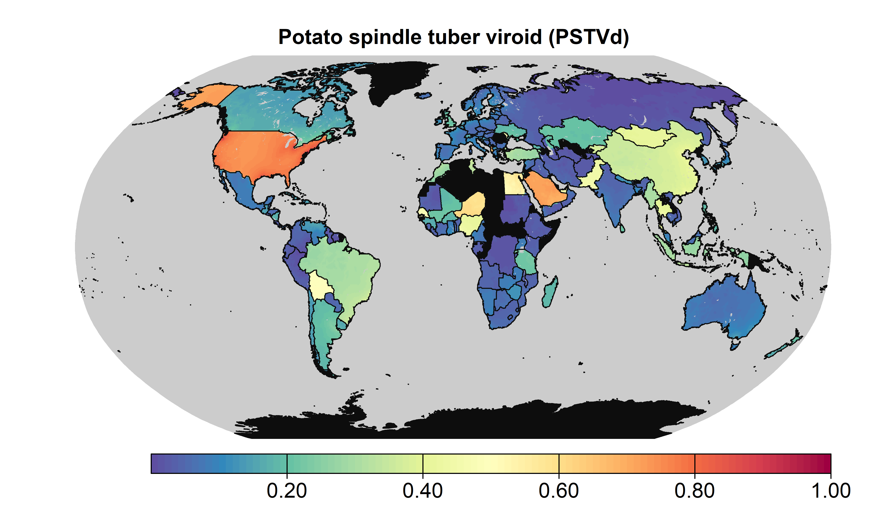
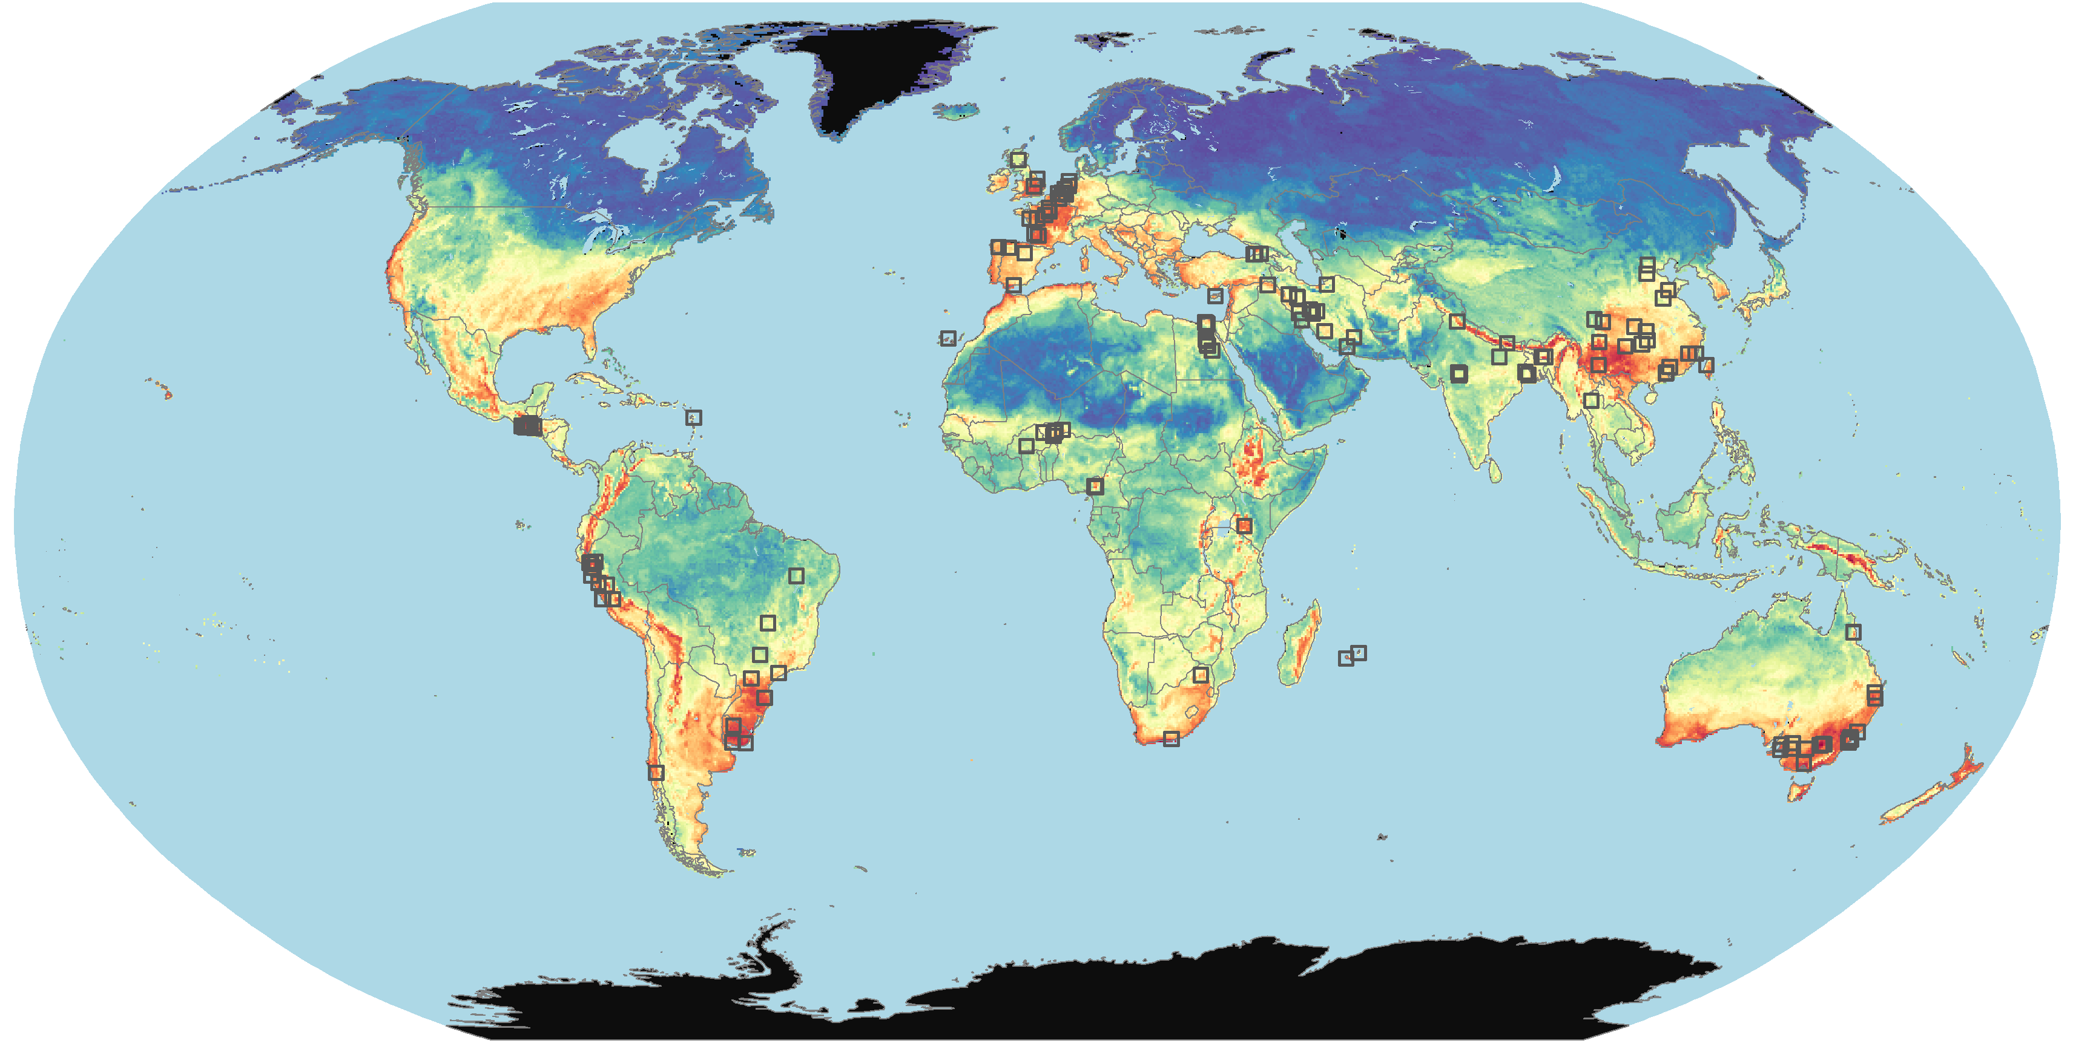
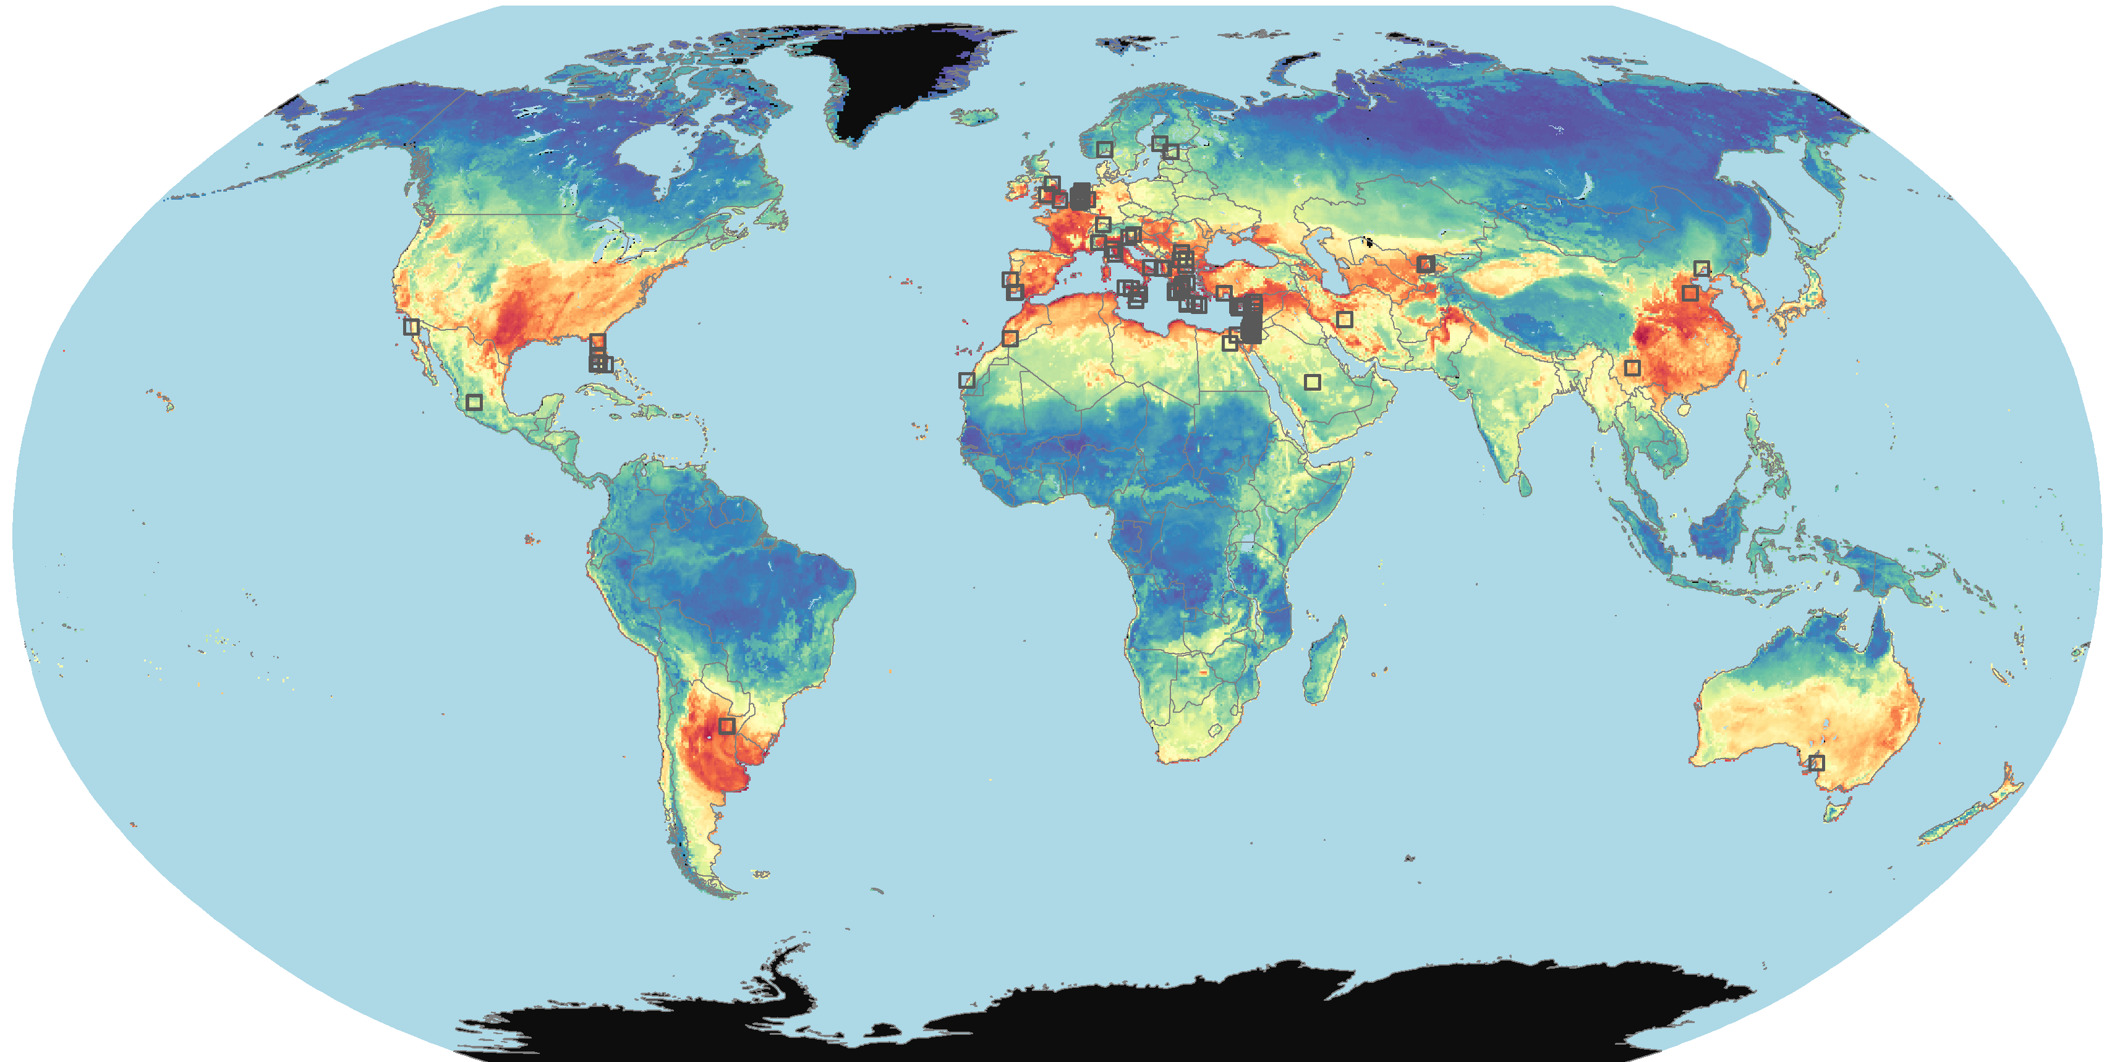
Mapping invasion risk based on pathogen environmental niche modeling
Harringtonia lauricola (n = 286)
Potato spindle tuber viroid (n = 75)
Estimated environmental suitability
High
Ralstonia solanacearum IIB1 (n = 151)
Tomato brown rugose fruit virus (n = 96)
Low
PLANT HEALTH 2025
n is the number of georeferenced outbreaks
15

